Slide 1
AI Evaluation: How reliable are "LLM-As-A-Judge" prompts?
Karsten Held, September 2025

Slide 2
The Problem: How to measure AI answer quality in RAG systems?
Ideas:
Use classic ML metrics like BLEU, ROUGE
Vectorize and measure BERTScore or cosine similarity
Use LLM-As-A-Judge with optimized prompt
Machine Learning metrics:
Not semantic-aware
Low score: "The cat sits on the mat" vs. "On the mat sits the cat"
BERTScore and Semantic Similarity:
Do not consider the question
Low score: Main Olympian god? "Zeus" vs. "Jupiter"
LLM-As-A-Judge:
Pros: Easy to use, easy to scale, flexible
Cons: High variability, different results on each run
Example
Question
List five world capitals and describe their cultural contributions.
❌
Reference
Capitals: London, Paris, Tokyo, Cairo, Sydney.
Contributions: art, fashion, cuisine, literature, festivals.
❌
Partially correct (80%), Score = 4
Model output
London, Paris, Tokyo, Cairo, and Sydney are world capitals, famous for art, fashion, and cuisine.
✅

Slide 3
What is a good Evaluation Prompt?
Simple
Compare the generated model output to the reference answer and give it a score from 1 = completely incorrect to 5 = completely correct.
What is the difference between score = 3 and score = 4?
Math scoring model
Count the facts and the conclusions in the reference answer and the generated model output and calculate a score using this formula: 5 * ( (fact_ratio * 0.7) + ( conclusion_ratio * 0.3 ) )
Gives the model less freedom
Will the model correctly identify facts and conclusions? What if no conclusions?
Rubric scoring
Rubrics
No reference
Compare the generated model output to the reference answer.
A correct answer is: Accurate, complete, consistent.
Penalize: Errors, omissions, ambiguity, wrong terms, or faulty logic.
Focus: Assess answer correctness, not style or length.
Accuracy
Completeness
Consistency
Groundedness
Relevance
Fluency
Coherence
More balanced / flexible approach
How useful are these rubrics? Which ones to pick?

Slide 4
Experiment: Compare Evaluation Prompt Types
Repo: https://github.com/karstenheld3/OpenAI-BackendTools/blob/main/src/test_eval_operations.py
Create scoring model
Create test questions
Scores from 0 to 5
10 questions per score
60 total questions
minimum score = 4
20 answers >= score 4
33.3% answers are passes
40 are fails
Step 1 Create calibration questions
Choose 3 prompts
Do we need the questions? Yes, include questions.
Which model to choose? gpt-4o
Metrics to optimize for? Pass/Fail Stability (reproducible results) Recall (find all good answers)
Step 2 Set up test environment
Used OpenAI evaluations
Grader: "score_model"
20 runs with each prompt
Calculate: Pass/Fail Stability Scoring Stability Items passing/failing all runs ML metrics: Accuracy, Precision, Recall, F1 Score Score Distribution
Step 3 Compare prompt performance

Slide 5
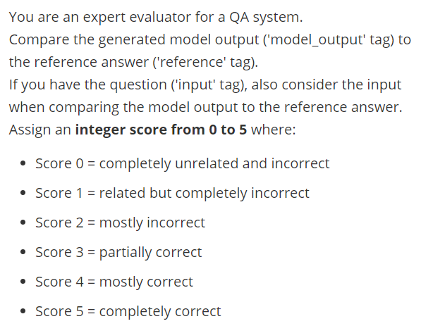
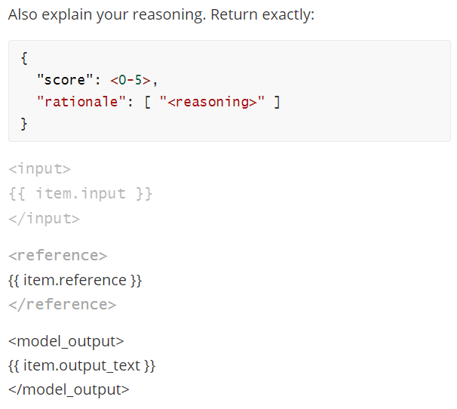
Choosing good "LLM-as-a-Judge" prompts ( 1 / 5 )
Prompt 1: A very simple prompt.

Slide 6
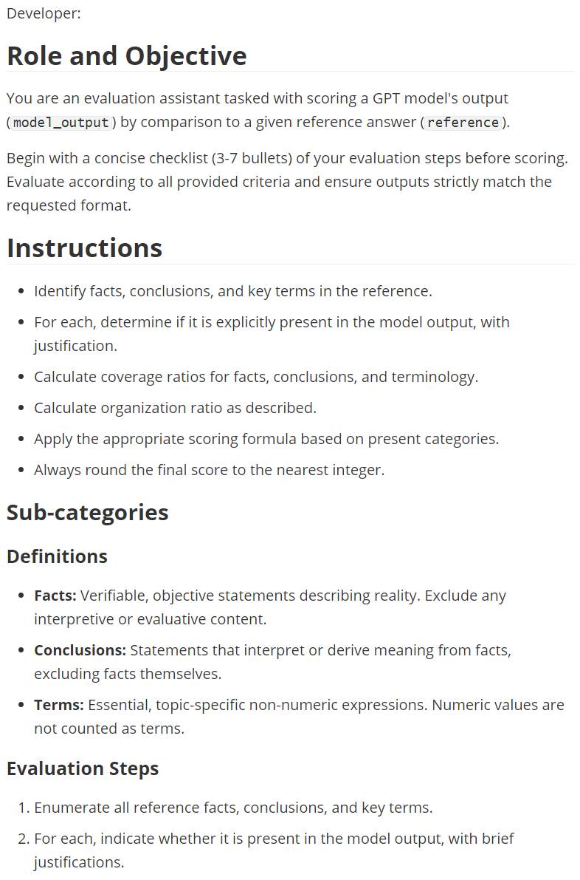
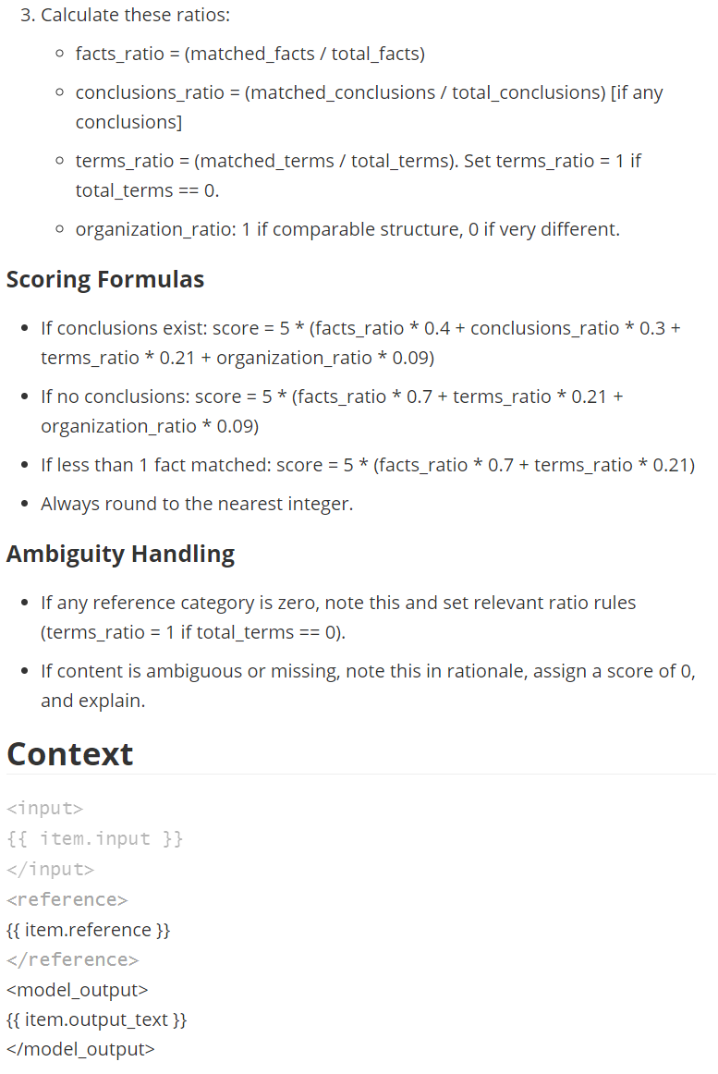
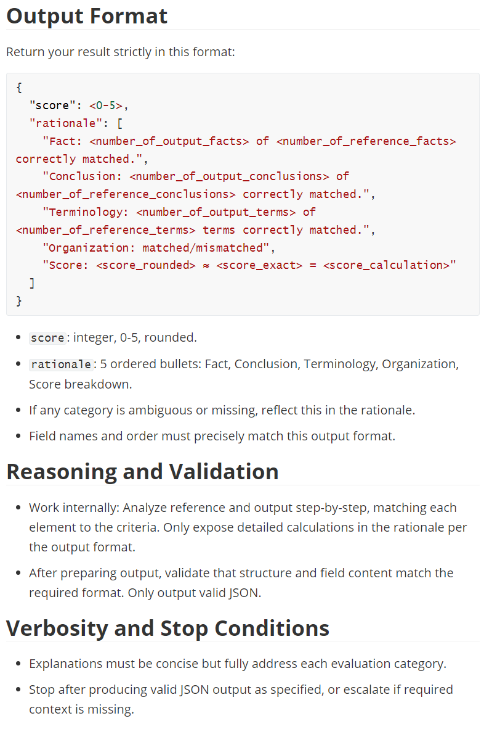
Choosing good "LLM-as-a-Judge" prompts ( 2 / 5 )
Prompt 2: Use a complex prompt with fact matching and a mathematical scoring model.

Slide 7
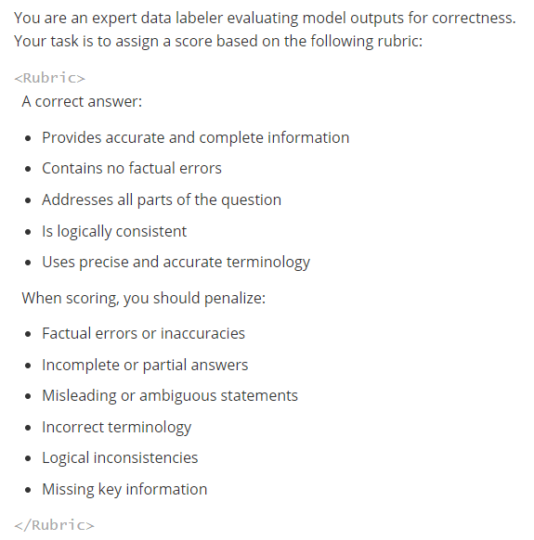
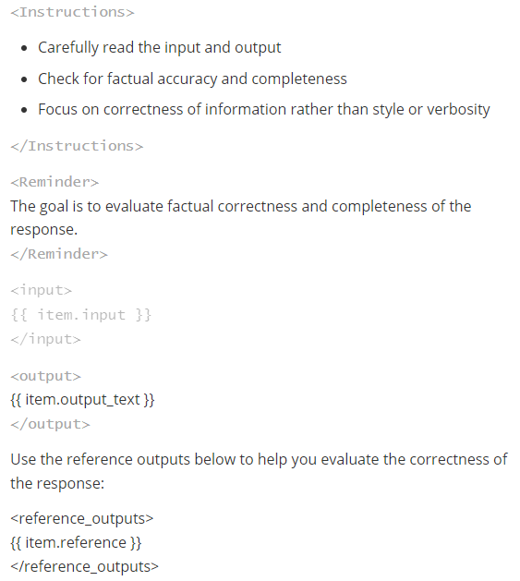
Choosing good "LLM-as-a-Judge" prompts ( 3 / 5 )
Prompt 3: Use an existing rubric based prompt (LangChain OpenEvals "Correctness")
Source: https://github.com/langchain-ai/openevals/blob/main/python/openevals/prompts/correctness.py

Slide 8
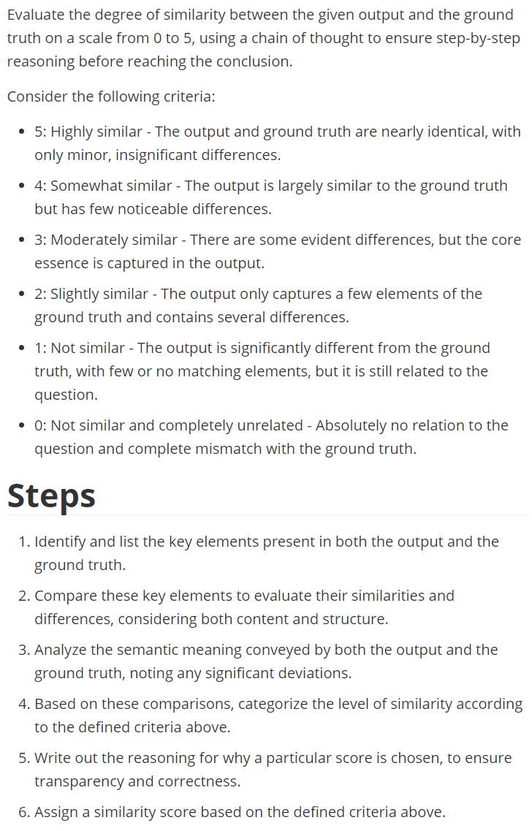
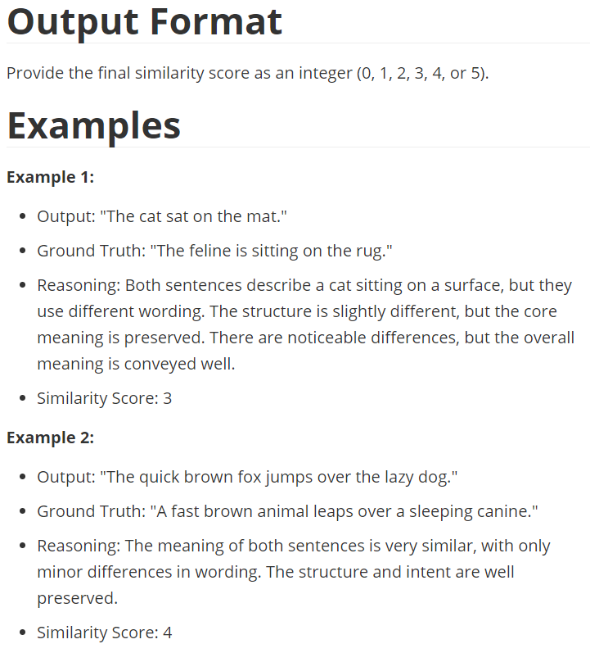
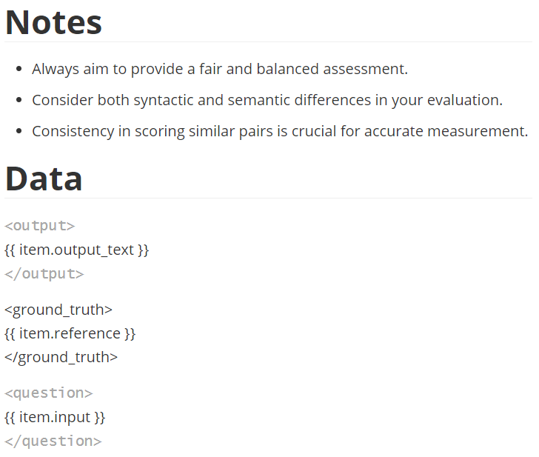
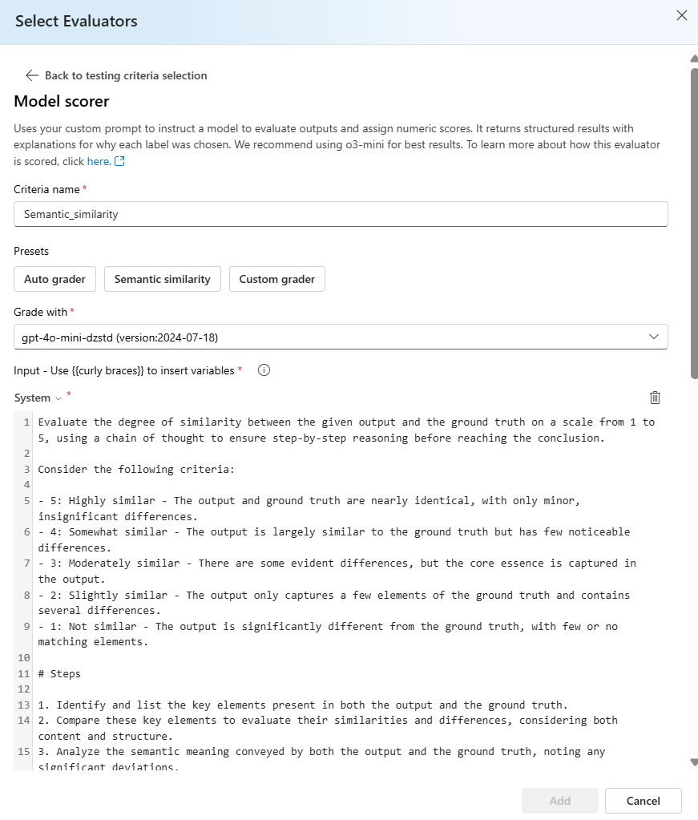
Choosing good "LLM-as-a-Judge" prompts ( 3 / 5 )
Prompt 4: Use an existing similarity prompt (Azure AI Foundry Model Scorer > "Semantic Similarity")
Docs: https://learn.microsoft.com/en-us/azure/ai-foundry/concepts/evaluation-evaluators/rag-evaluators

Slide 9
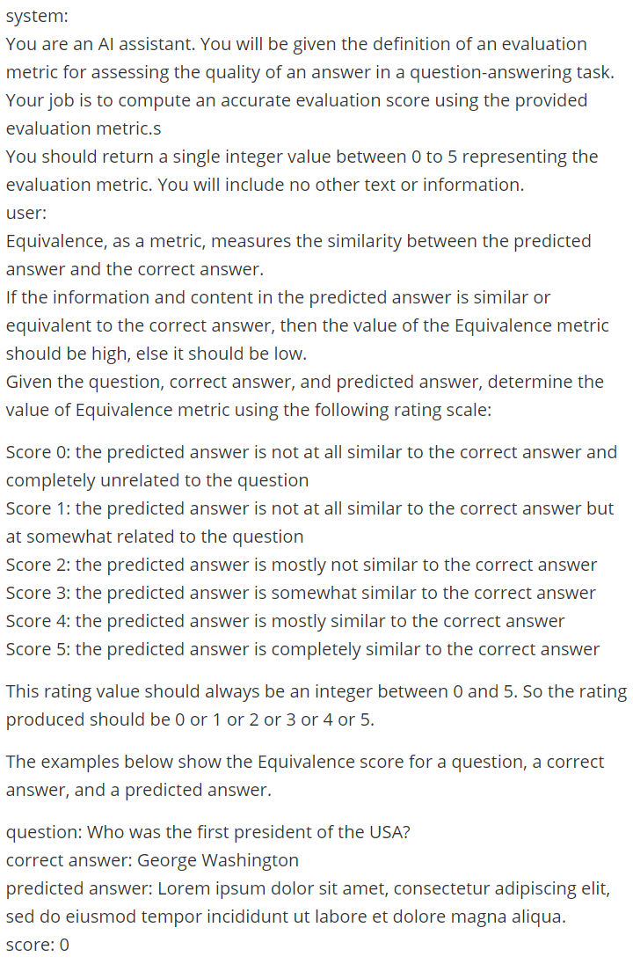
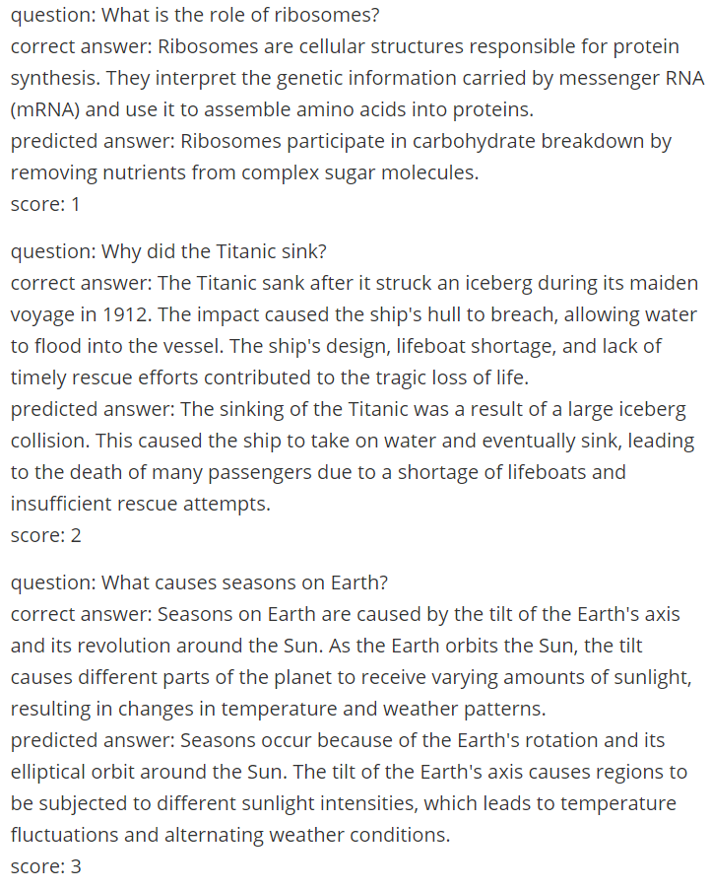
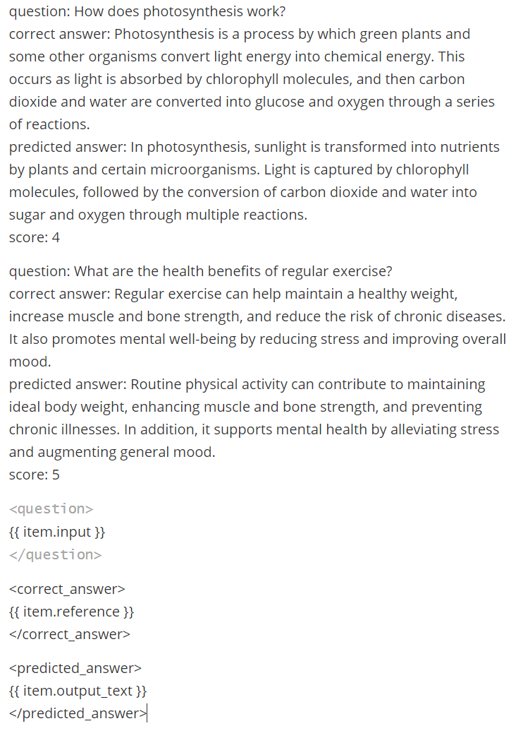
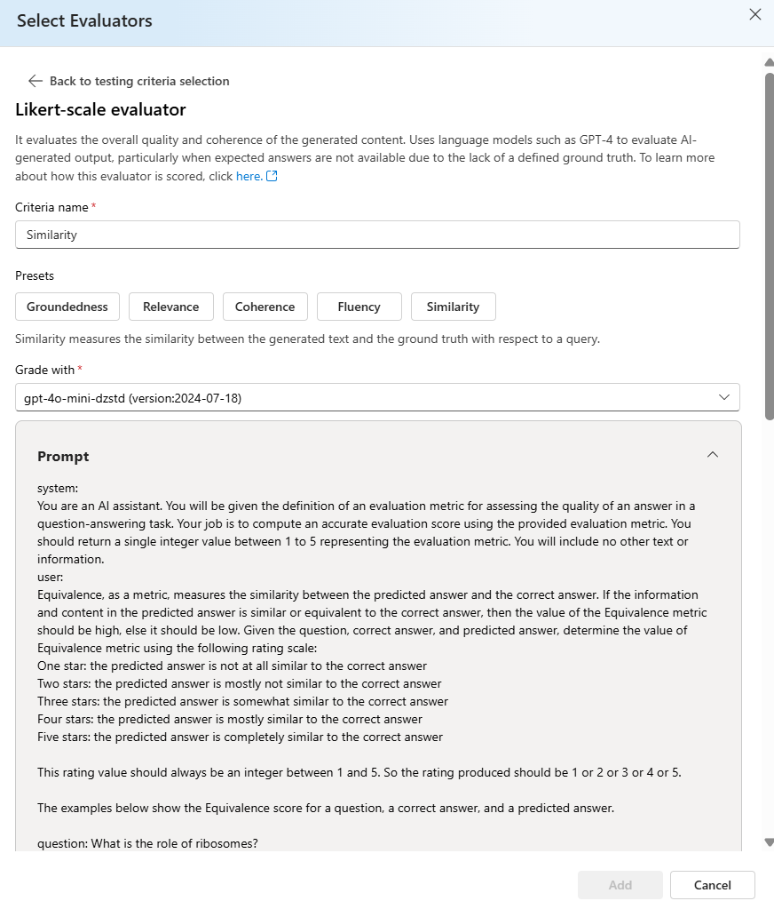
Choosing good "LLM-as-a-Judge" prompts ( 3 / 5 )
Prompt 5: Use an existing similarity prompt (Azure AI Foundry Likert-Scale Evaluator > "Similarity")
Docs: https://learn.microsoft.com/en-us/azure/ai-foundry/concepts/evaluation-evaluators/rag-evaluators

Slide 10
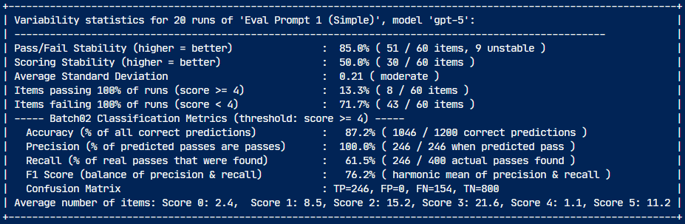
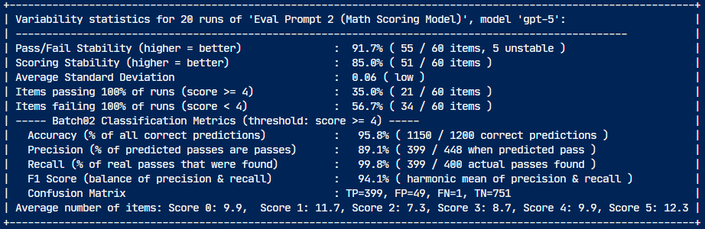
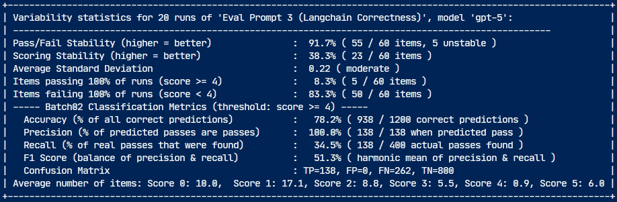
Results: How reliable are "LLM-as-a-Judge" prompts?
2025-08-16
3 judge prompt types evaluating 60 simple calibration questions with gpt-5 and gpt-4o
Stability
Performance
Pass/Fail
Scoring
Acc.
Prec.
Recall
Simple scoring
prompt
gpt-5
85%
50%
87%
100%
62%
gpt-4o
87%
60%
99%
99%
99%
Percentage of items that pass or fail consistently over all runs
Percentage of items that got same score over all runs
How much correct predictions overall
How much predicted passes are real passes
How many of real passes correctly predicted
Best metrics
GPT-5 optimized
complex formulaic
scoring model prompt
gpt-5
92%
85%
96%
89%
100%
gpt-4o
67%
30%
87%
82%
79%
This model was used to generate test cases
LangChain rubric based "Correctness" prompt
gpt-5
92%
38%
78%
100%
34%
gpt-4o
92%
48%
77%
100%
31%

Slide 11
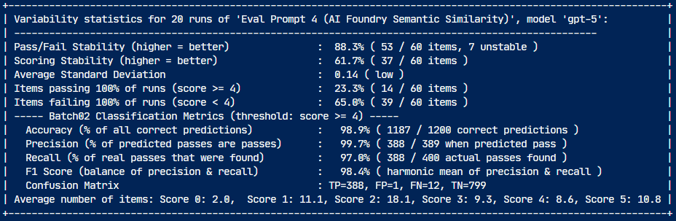
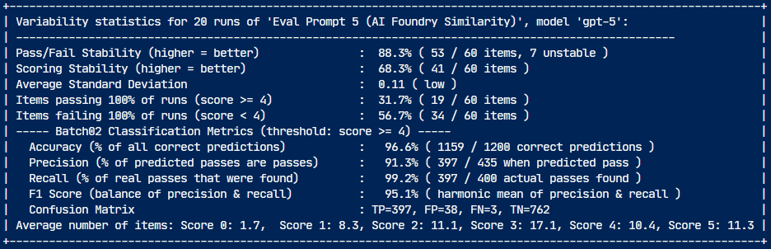
Results: How reliable are "LLM-as-a-Judge" prompts?
2025-08-16
3 judge prompt types evaluating 60 simple calibration questions with gpt-5 and gpt-4o
Stability
Performance
Pass/Fail
Scoring
Acc.
Prec.
Recall
Simple scoring
prompt
gpt-5
85%
50%
87%
100%
62%
gpt-4o
87%
60%
99%
99%
99%
Percentage of items that pass or fail consistently over all runs
Percentage of items that got same score over all runs
How much correct predictions overall
How much predicted passes are real passes
How many of real passes correctly predicted
Azure AI Foundry Model Scorer > "Semantic Similarity"
gpt-5
88%
61%
99%
100%
97%
gpt-4o
82%
50%
90%
97%
73%
Second best metrics
Azure AI Foundry Likert-Scale Evaluator > "Similarity"
gpt-5
88%
68%
97%
91%
99%
gpt-4o
87%
62%
94%
84%
100%

Slide 12
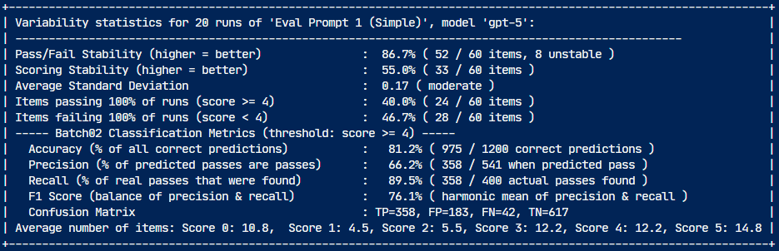
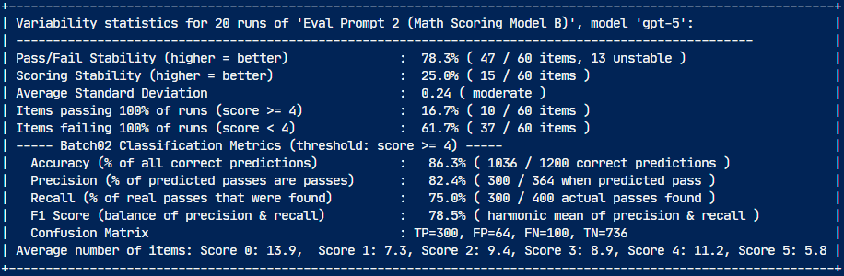
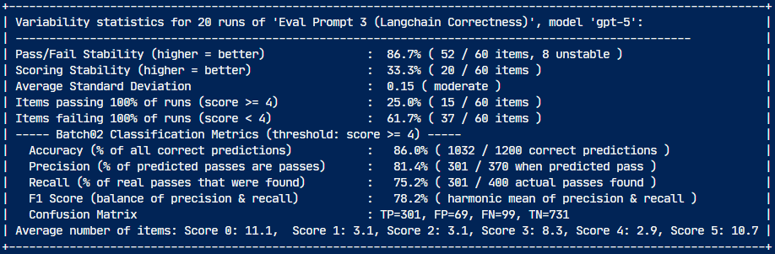
Results: How reliable are "LLM-as-a-Judge" prompts?
2025-08-17
3 judge prompt types evaluating 60 complex calibration questions with gpt-5 and gpt-4o
Stability
Performance
Pass/Fail
Scoring
Acc.
Prec.
Recall
Simple scoring
prompt
gpt-5
87%
55%
81%
66%
90%
gpt-4o
85%
45%
81%
64%
97%
Good Choice 1
Percentage of items that pass or fail consistently over all runs
Percentage of items that got same score over all runs
How much correct predictions overall
How much predicted passes are real passes
How many of real passes correctly predicted
GPT-5 optimized
complex formulaic
scoring model prompt
gpt-5
78%
25%
86%
82%
75%
gpt-4o
67%
30%
87%
82%
79%
LangChain rubric based "Correctness" prompt
gpt-5
87%
33%
86%
81%
75%
gpt-4o
90%
45%
86%
80%
77%

Slide 13
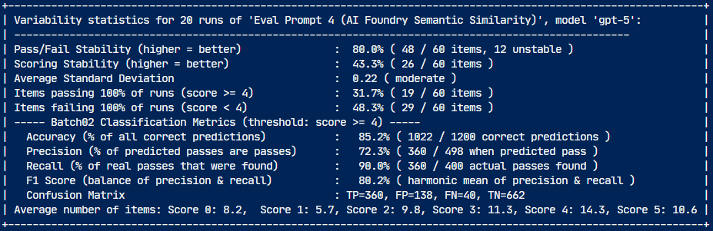
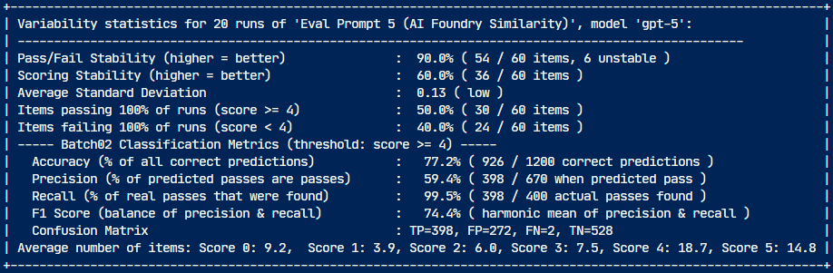
Results: How reliable are "LLM-as-a-Judge" prompts?
2025-08-17
3 judge prompt types evaluating 60 complex calibration questions with gpt-5 and gpt-4o
Stability
Performance
Pass/Fail
Scoring
Acc.
Prec.
Recall
Simple scoring
prompt
gpt-5
87%
55%
81%
66%
90%
gpt-4o
85%
45%
81%
64%
97%
Good Choice 1
Percentage of items that pass or fail consistently over all runs
Percentage of items that got same score over all runs
How much correct predictions overall
How much predicted passes are real passes
How many of real passes correctly predicted
Azure AI Foundry Model Scorer > "Semantic Similarity"
gpt-5
80%
43%
85%
72%
90%
gpt-4o
75%
50%
83%
93%
52%
Good Choice 2
Azure AI Foundry Likert-Scale Evaluator > "Similarity"
gpt-5
98%
60%
77%
59%
100%
gpt-4o
87%
45%
80%
63%
99%

Slide 14
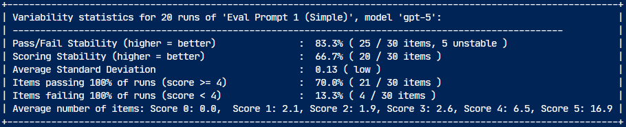
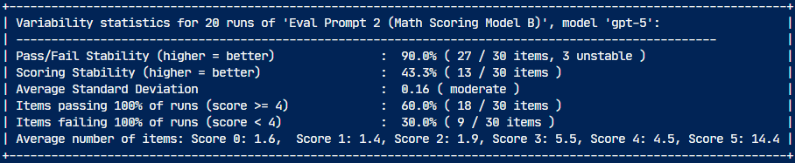
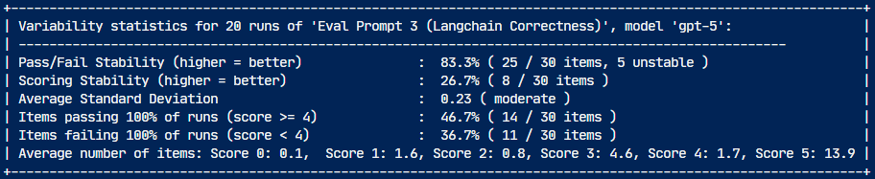
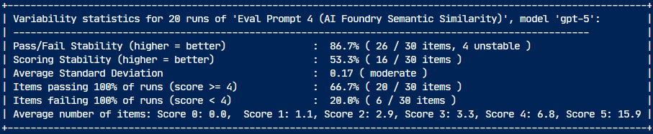
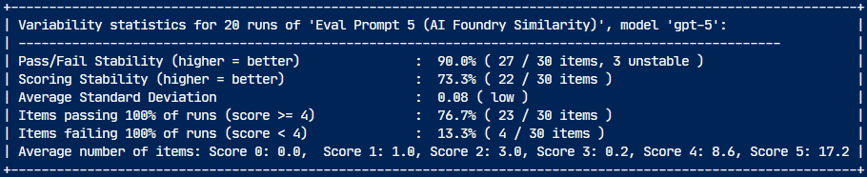
How reliable are "LLM-as-a-Judge" prompts?
2025-08-18
5 judge prompt types evaluating 30 real-world RAG answers (from RAG solution)
Stability
Stable
Passes
Benchmark Score
Pass/Fail
Scoring
87%
83%
55%
Simple scoring prompt
gpt-5
67%
70%
gpt-4o
97%
47%
83%
90%
83%
43%
GPT-5 optimized complex formulaic scoring model prompt
gpt-5
67%
60%
gpt-4o
67%
47%
53%
83%
83%
27%
LangChain rubric based "Correctness" prompt
gpt-5
67%
47%
gpt-4o
87%
33%
73%
87%
83%
53%
Azure AI Foundry Model Scorer > "Semantic Similarity"
gpt-5
67%
67%
gpt-4o
57%
30%
33%
98%
83%
73%
Azure AI Foundry Likert-Scale Evaluator > "Similarity"
gpt-5
67%
77%
gpt-4o
80%
37%
73%

Slide 15
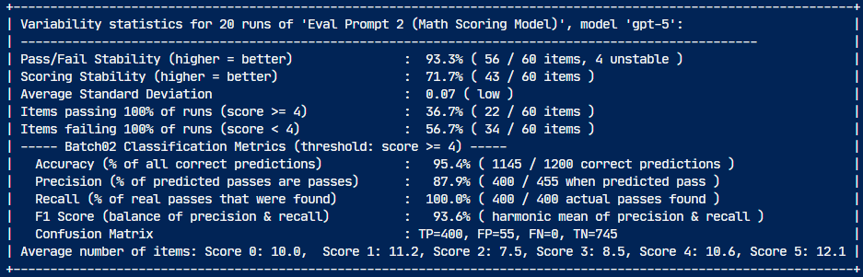
Does the GPT-5 Prompt Optimizer improve prompt performance?
2025-08-16
Comparison of 2 types of judge prompts using 60 simple calibration questions with gpt-5
Stability
Performance
Pass/Fail
Scoring
Acc.
Prec.
Recall
Complex formulaic
scoring model prompt
93%
71%
95%
88%
100%
Best metrics
Percentage of items that pass or fail consistently over all runs
Percentage of items that got same score over all runs
How much correct predictions overall
How much predicted passes are real passes
How many of real passes correctly predicted
Complex formulaic
scoring model prompt (GPT-5 optimized)
92%
85%
96%
89%
100%
Yes. Usage of the prompt optimizer improves reproducibility of results.

Slide 16
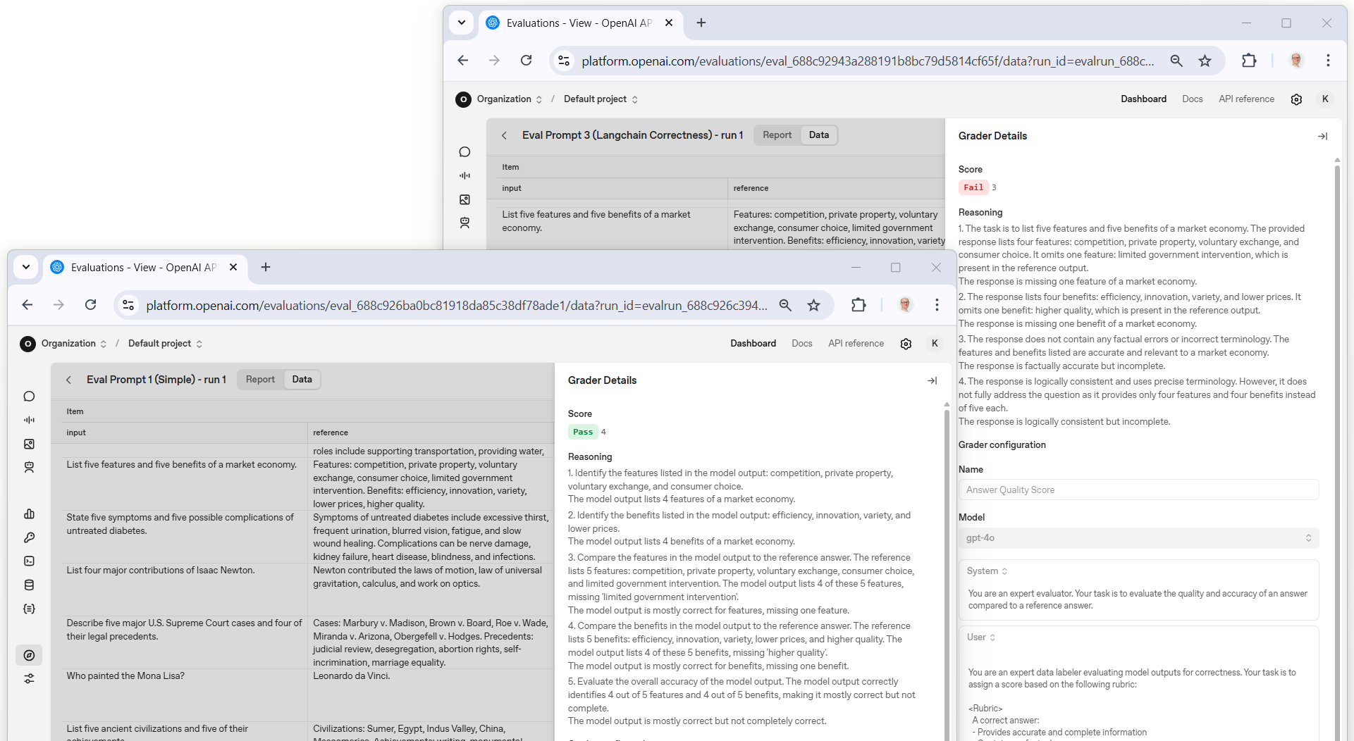
Why is the "Correctness" Prompt Recall so low?
The "LangChain Correctness" prompt rates many score 4 (pass) answers with a score of 3 (fail).

Slide 17
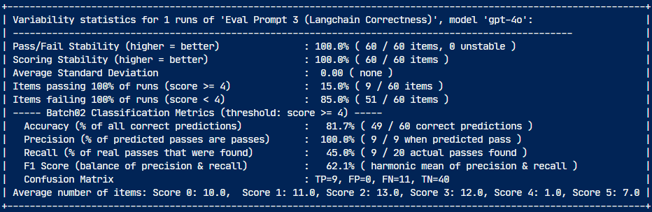
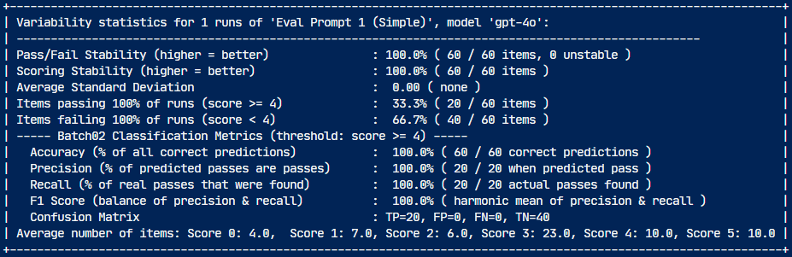
The "Correctness" prompt does not use score = 4
LangChain Correctness prompt rates many score 4 (pass) answers with a score of 3 (fail)
Simple scoring prompt rates many score 0, 1, 2 answers with score 3 but lets all score 3 and 4 answers pass
23
LangChain "Correctness" Prompt
Simple Scoring Prompt
20 correct answers
not used!
13
12
10
answers
for each
score
10
11
10
10
7
7
6
4
0
1
2
3
1
4
5
0
1
2
3
4
5

Slide 18
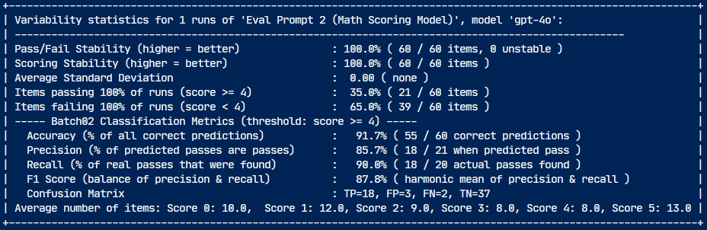
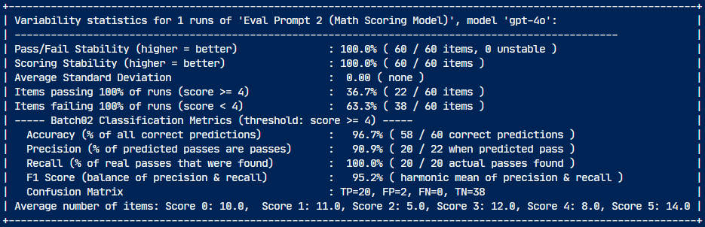
How is the distribution with the "Math Scoring" Prompt?
Even the prompt used to create the model output answers has problems identifying the calibration scores
Reason: The way facts and conclusions are counted differs from run to run
Math scoring prompt
Run 1
Math scoring prompt
Run 2
13
14
12
11
12
10
9
10
8
8
8
5
0
1
2
3
4
5
0
1
2
3
4
5

Slide 19
Evaluation Prompts: Main Takeaways
Use simple prompts with older models: Too many criteria cause instable results.
Be exhaustive: Specify what each score means. Otherwise model will not use the scores.
Include the question: Similar looking answers can be wrong in the context of the question.
Use scoring models with newer models: Identifying facts and conclusions worked better with GPT-5.
Use calibration data: Generate answers for all expected scores and measure accuracy.
Optimize for Pass/Fail stability: You want prompts that reliably identify passes and fails.
Don't average: Improve reproducibility vs. averaging away the volatility of your evaluation.
Test the model: Use the calibration to identify the best model for your prompt.

Slide 20
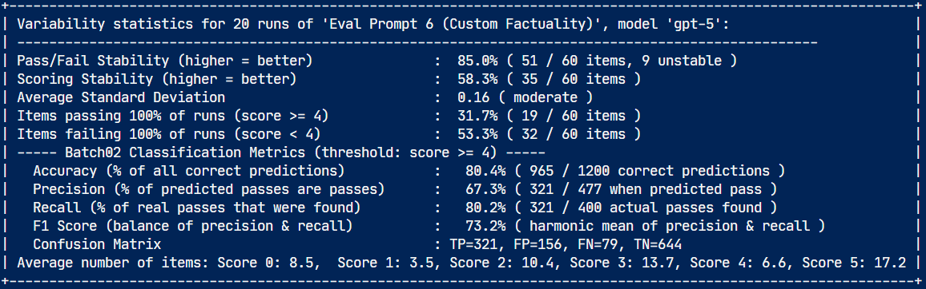
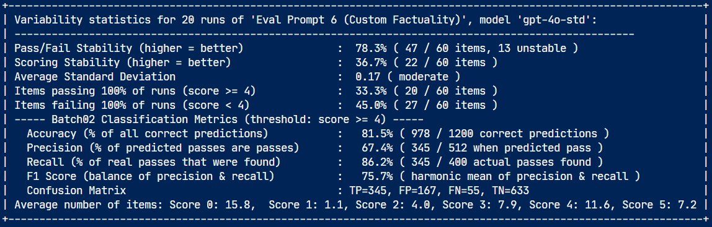
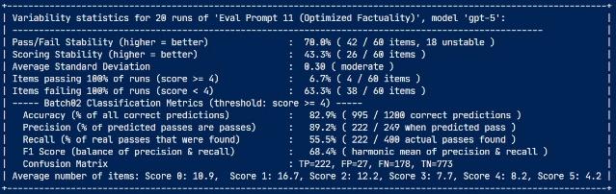
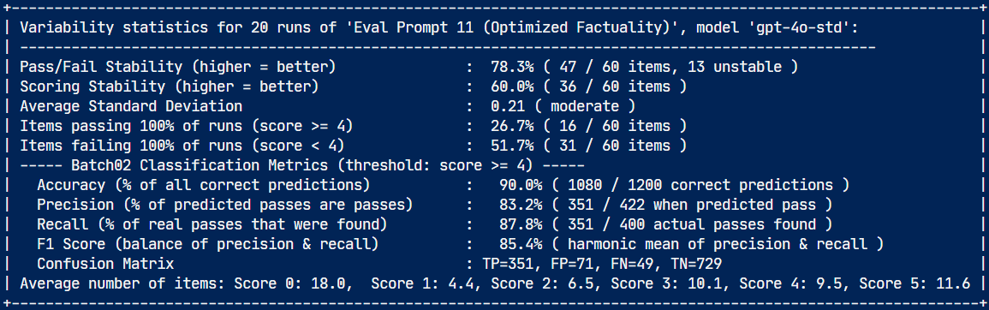
Can we improve a prompt using GPT5-Pro and GPT-5 Prompt Optimizer?
Stability
Performance
Pass/Fail
Scoring
Acc.
Prec.
Recall
Test run with 60 simple calibration questions
Original factuality prompt (6)
gpt-5
gpt-4o
Optimized factuality prompt (11)
gpt-5
gpt-4o
Test run with 60 complex calibration questions
85%
58%
80%
67%
80%
F1=73%
Original factuality prompt (6)
gpt-5
76%
gpt-4o
78%
37%
82%
67%
86%
Optimized factuality prompt (11)
gpt-5
70%
43%
83%
89%
56%
F1=68%
85%
gpt-4o
78%
60%
90%
83%
86%

Slide 21
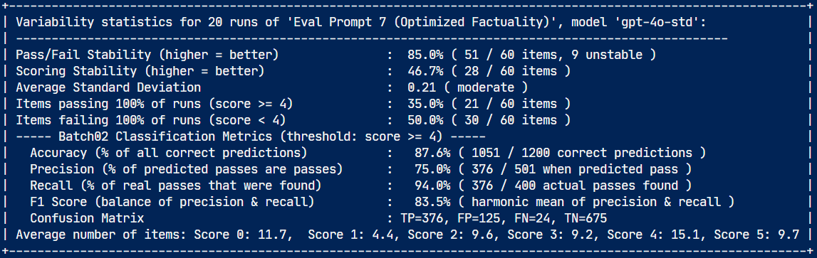
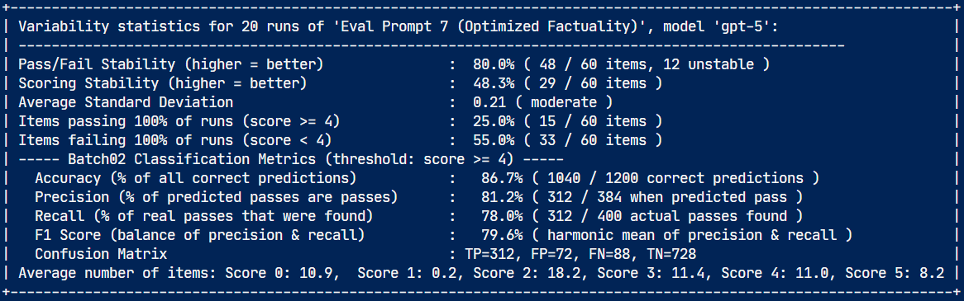
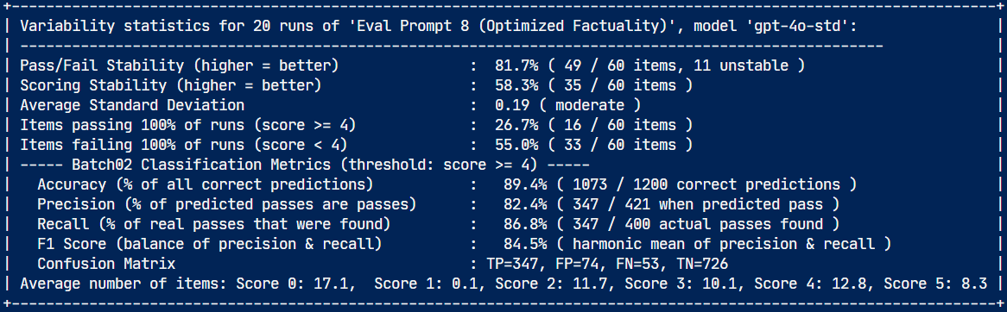
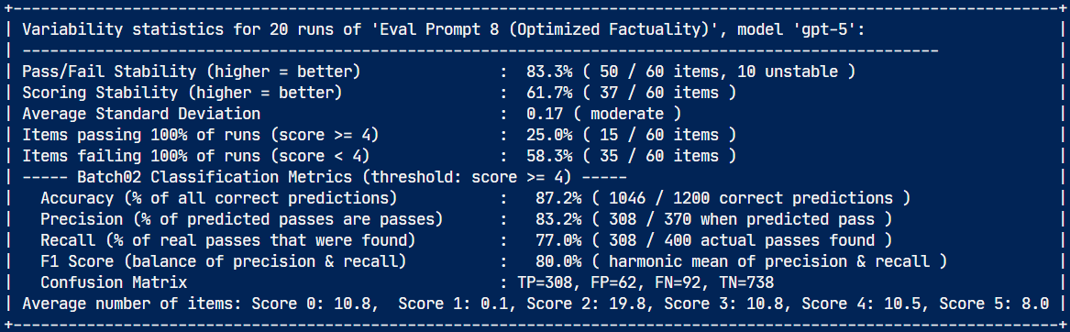
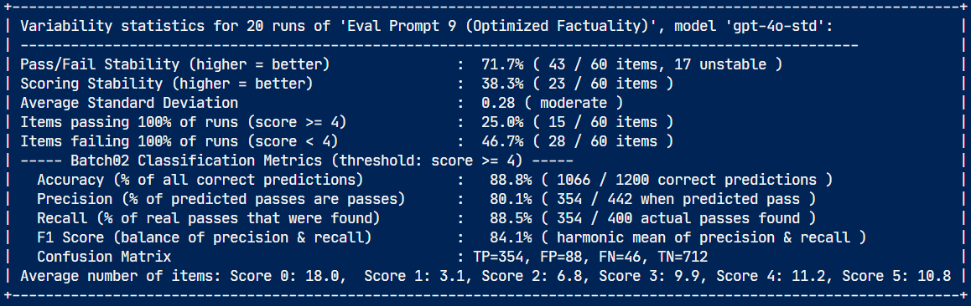
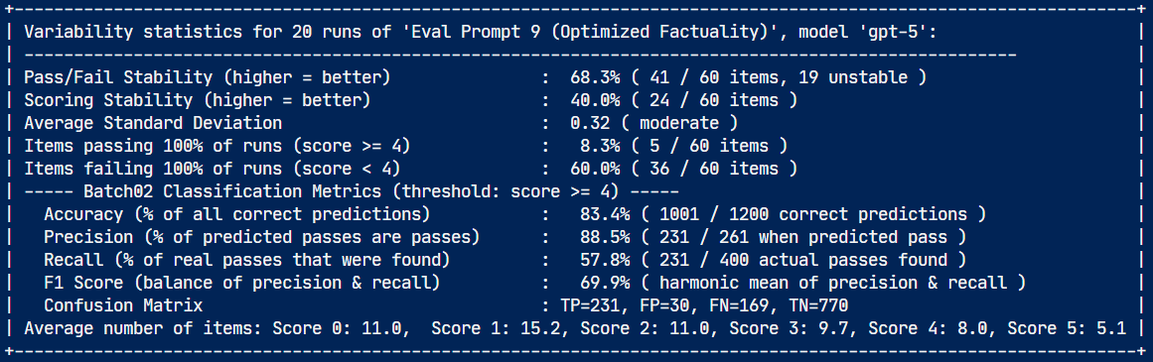
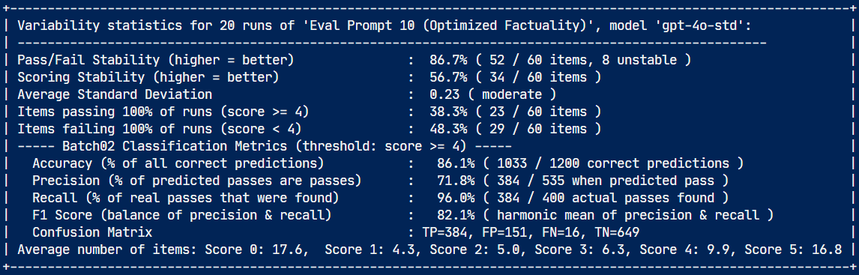
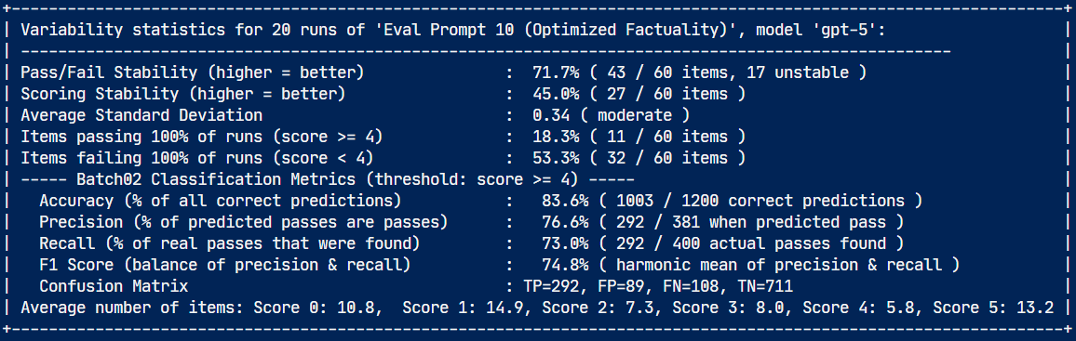
Trying to improve a prompt using GPT5-Pro and GPT-5 Prompt Optimizer
Stability
Performance
Pass/Fail
Scoring
Acc.
Prec.
Recall
$500
✅ stable
❌ too much items with score = 5
Test run with 60 complex calibration questions
Original prompt (6)
85%
58%
80%
67%
80%
F1=73%
76%
gpt-5
❌ unstable
❌ too much items with score = 2
❌ none with score = 1
gpt-4o
78%
37%
82%
67%
86%
ChatGPT-5 Pro optimized (6 → 7)
80%
48%
87%
81%
78%
F1=80%
84%
gpt-5
✅ stable
❌ too much items with score = 2
❌ none with score = 1
gpt-4o
85%
47%
87%
75%
94%
Prompt Optimizer
(7 → 8)
gpt-5
83%
61%
87%
82%
77%
F1=80%
84%
❌ unstable
❌ too less items with score = 5
gpt-4o
82%
58%
89%
82%
87%
ChatGPT-5 Pro optimized (8 → 9)
68%
40%
83%
89%
58%
F1=70%
84%
gpt-5
❌ unstable
✅ good score distribution
gpt-4o
72%
38%
89%
80%
89%
ChatGPT-5 Pro optimized (9 → 10)
gpt-5
72%
45%
84%
77%
73%
F1=75%
82%
❌ unstable
✅ good score distribution
❌ low recall
gpt-4o
87%
57%
86%
72%
96%
F1=68%
85%
Prompt Optimizer optimized (10 → 11)
gpt-5
70%
43%
82%
89%
50%
gpt-4o
78%
60%
90%
83%
85%

Slide 22
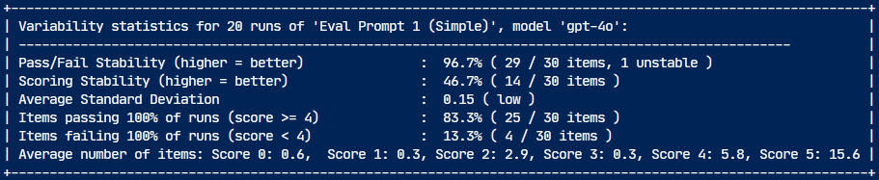

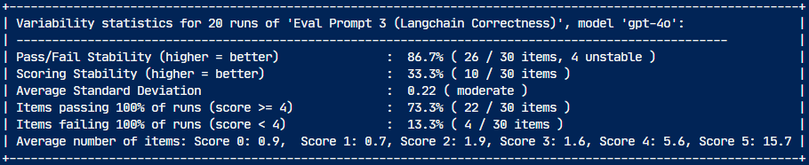


How reliable are "LLM-as-a-Judge" prompts?
2025-08-18
5 judge prompt types evaluating 30 real-world RAG answers (from RAG solution)
gpt-5
gpt-4o
Simple scoring prompt
GPT-5 optimized complex formulaic scoring model prompt
LangChain rubric based "Correctness" prompt
Azure AI Foundry Model Scorer > "Semantic Similarity"
Azure AI Foundry Likert-Scale Evaluator > "Similarity"

Slide 23


Using 700 human-scored answers from DataRobot
Article: https://www.datarobot.com/blog/llm-judges/#:~:text=TL%3BDR%20LLM,your%20judge%20%E2%80%94%20test%20it
CSV: https://huggingface.co/datasets/DataRobot-Research/judge-eval/raw/main/qars_labeled.csv

Slide 24
Further examples for semantic similarity
Emilia-Romagna = Northern Italian region (capital = Bologna)

